Slide 1
Mobile Computing
Broadcast Systems

Slide 2
Unidirectional distribution systems
Need of an asymmetric communication system
Bandwidth limitations,
Differences in transmission power,
Cost factors
Problems of unidirectional broadcast systems
A sender can optimize transmitted information only for one group of users/terminals
Functions needed to individualize personal requirements/applications

Slide 3
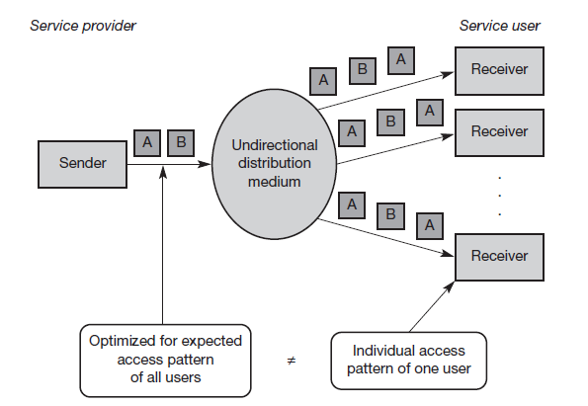
Broadcast transmission

Slide 4
Cyclical repetition of data
Sender
Broadcast Disk
Different patterns possible (optimization possible only if the content is known)
Receiver
Task of caching
Cost-based strategy: what are the costs for a user (waiting time) if a data block has been requested but is currently not cached
Application and cache have to know content of data blocks and access patterns of user to optimize
flat disk
A
B
C
A
B
C
skewed disk
A
A
B
C
A
A
multi-disk
A
B
A
C
A
B

Slide 5
DAB: Digital Audio Broadcasting
Offers CD-like quality
Immune to interference and multi-path propagation effects
Uses Single Frequency Networks (SFN)
All senders transmitting the same radio program operate at the same frequency.
A single radio station only needs one frequency throughout the whole country.
DAB transmission power per antenna is orders of magnitude lower compared to traditional FM stations

Slide 6
DAB: Digital Audio Broadcasting
Uses VHF (174–230 MHz) and UHF frequency bands (L-band :1452–1492 MHz).
Modulation scheme used is DQPSK.
Uses COFDM (Coded Orthogonal Frequency Division Multiplex)
192 to 1536 subcarriers (ensemble) within a 1.5 MHz channel.
Uses FEC to reduce the error rate and introduces guard spaces between single symbols during transmission.
Reduces ISI to a minimum
Can benefit from multipath propagation by recombining the signals from different paths.
Notes:
Differential 4-phase modulation (D-QPSK)
FEC-forward error correction

Slide 7
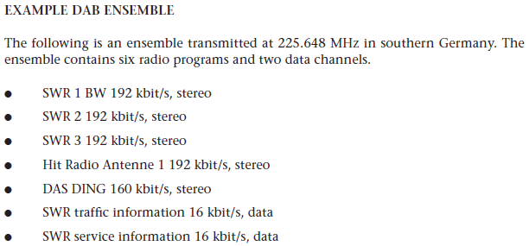
EXAMPLE DAB ENSEMBLE

Slide 8
Multi-Carrier Modulation
OFDM or COFDM
Parallel data transmission on several orthogonal subcarriers with lower rate
Maximum of one subcarrier frequency appears exactly at a frequency where all other subcarriers equal zero
c
k₃
f
t
Notes:
orthogonal frequency division multiplexing
COFDM-If additional error-control coding across the symbols in different subcarriers is applied

Slide 9
DAB
Can transmit up to 6 stereo audio programmes in 1.5MHz Channel
data rate of 192 kbit/s each.
For DAB transmission system, audio is just another type of data

Slide 10
DAB Transport mechanisms
Main service channel (MSC)
Carries all user data
Fast information channel (FIC)
Carries all control information

Slide 11
Main service channel (MSC)
Carries all user data
Consists of common interleaved frames (CIF)
Data fields of 55,296 bits that are sent every 24 ms
Results in a data rate of 2.304 Mbit/s
A CIF consists of capacity units (CU) with a size of 64 bits, which form the smallest addressable unit within a DAB system

Slide 12
Main service channel (MSC)
Transport Modes
The stream mode
Offers a transparent data transmission from the source to the destination with a fixed bit rate in a sub channel.
A sub channel is a part of the MSC and comprises several CUs within a CIF.
Fixed data rate can be multiples of 8 kbit/s.
The packet mode
Transfers data in addressable blocks (packets).
These blocks are used to convey MSC data within a sub channel.

Slide 13
Fast information channel (FIC)
Carries all control information
Required for interpreting the configuration and content of the MSC.
Contains fast information blocks (FIB) with 256 bits each (16 bit checksum)

Slide 14
DAB
Very limited information with the program in the traditional Analog s/m.
DAB defines program associated data (PAD) as service information structures accompanying an audio stream.
Program information, control information, still pictures for display on a small LCD, title display etc.
Audio coding uses PCM with a sampling rate of 48KHz and MPEG audio compression.
The compressed audio stream can have bit rates ranging from 8 kbit/s to 384 kbit/s.
Audio data is interleaved for better burst tolerance.

Slide 15
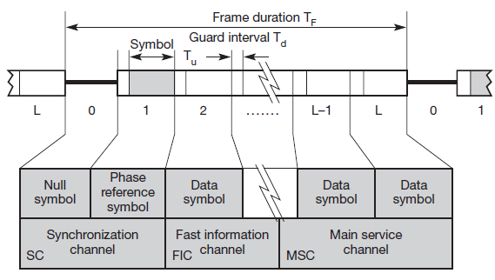
DAB frame structure

Slide 16
DAB frame structure
TF can be 24, 48, or 96 ms depending on the transmission modes (IV modes).
Within each frame, 76 or 153 symbols are transmitted using 192, 384, 768, or 1,536 different carriers for COFDM.
The guard intervals Td protecting each symbol can be 31, 62, 123, or 246 μs.
Parts of DAB frame
The synchronization channel (SC): marks the start of a frame.
Consists of a null symbol and a phase reference symbol to synchronize the receiver.
The fast information channel (FIC) : containing control data in the FIBs.
The main service channel (MSC) carries audio and data service components.

Slide 17
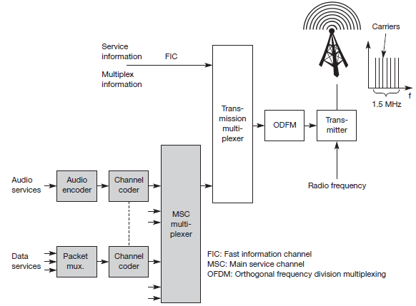
DAB Sender
OFDM

Slide 18
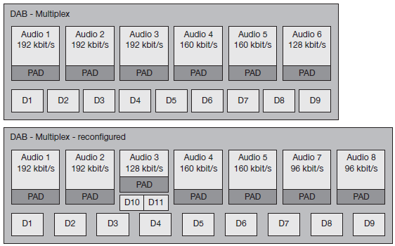
Dynamic reconfiguration of the DAB multiplexer

Slide 19
Dynamic reconfiguration
DAB does not require fixed, pre-determined allocation of channels with certain properties to services.
The DAB multiplexer dynamically interleaves data from all different sources.
The FIC sends multiplex configuration information (MCI)
To inform the receiver about the current configuration of the MSC

Slide 20
Multi-media Object Transfer Protocol
Receiver capabilities are the problem facing by the technologies like DAB.
All types of receivers should be able to recognize all program associated and program-independent data, and process some of this data.
Soln: A common standard – MOT
Primary goal of MOT is the support of data formats used in other multi-media systems.

Slide 21

MOT Object
MOT data is transferred in MOT objects consisting of a header core, a header extension, and a body.
Header core
7 byte field
Contains the sizes of the header and the body
The content type of the object.
Receiver may decide if it has enough resources available to decode and further process the object based on this info.

Slide 22
MOT Object
Header extension
Variable in size
Contains additional handling data for the object
Like the repetition distance to support advanced caching strategies, the segmentation information, and the priority of the data.
Decide which data to cache and which to replace.
Body
Arbitrary data can be transferred in the variable body as described in the header fields.

Slide 23
MOT Segmentation Schemes
Larger MOT objects will be segmented into smaller segments.
Object repetition:
DAB can repeat objects several times. If an object A consists of four segments (A1, A2, A3, and A4), a simple repetition pattern would be A1A2A3A4A1A2A3A4A1A2A3A4...
Interleaved objects:
To mitigate burst error problems, DAB can also interleave segments from different objects. Interleaving the objects A, B, and C could result in the pattern A1B1C1A2B2C2A3B3C3...
Segment repetition:
If some segments are more important than others, DAB can repeat these segments more often (e.g. A1A1A2A2 A2A3A4A4...).
Header repetition:
If a receiver cannot receive the header of an MOT, it will not be able to decode the object. It can be useful to retransmit the header several times. Then, the receiver can synchronize with the data stream as soon as it receives the header and can start decoding. A pattern could be HA1A2HA3A4HA5A6H... with H being the header of the MOT object A.
Can also apply all interleaving and repetition schemes at the same time.

Slide 24
Digital Video Broadcasting
Unchanged technology
Low resolution
Display is interlaced with 25 or 30 frames per second respectively.
Compared with today’s computer displays, performance is not very impressive.
No attempts to change this been truly successful.
Huge number of old systems that are installed.
Named as DVB in 1993.
(DVB-S, (ETSI, 1997, (DVB-C, (ETSI, 1998)), (DVB-T, (ETSI, 2001b)).

Slide 25
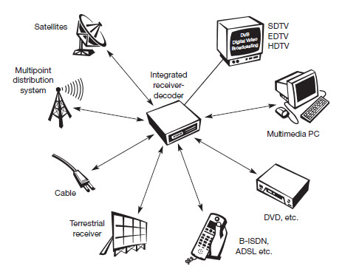
DVB Architecture

Slide 26
DVB Architecture
The center point
An integrated receiver-decoder (set-top box) connected to a high-resolution monitor.
Receive DVB signals
via satellites, terrestrial local/regional senders (multi-point distribution systems, terrestrial receiver), cable, B-ISDN, ADSL, or other possible future technologies.
Cable, ADSL, and B-ISDN connections also offer a return channel,
A user can send data such as channel selection, authentication information, or a shopping list.

Slide 27
DVB
Audio/video streams can be recorded, processed, and replayed.
Different levels of quality are envisaged:
Standard definition TV (SDTV),
Enhanced Definition TV (EDTV), and
High definition TV (HDTV) with a resolution of up to 1,920 × 1,080 pixels.

Slide 28
DVB
DVB also transmits data using flexible containers.
MPEG-2 frames that do not restrict the type of information.
Sends service information contained in its data stream.
Specifies the content of a container.
Container can store different types of data.

Slide 29
Types of Contents
Network information table (NIT):
Lists the services of a provider and contains additional information for set-top boxes.
Service description table (SDT):
Lists names and parameters for each service within an MPEG multiplex channel.
Event information table (EIT):
Contains status information about the current transmission and some additional information for set-top boxes.
Time and date table (TDT):
Contains update information for set-top boxes.

Slide 30
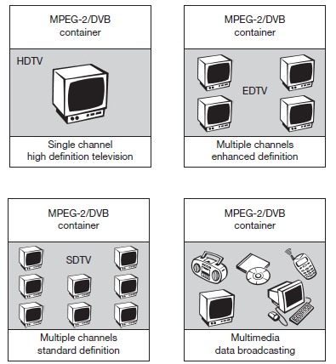
Different contents of MPEG- 2/DVB containers

Slide 31
DVB Data Broadcasting
MPEG-2 transport stream is able to carry arbitrary data within packets.
Fixed length of 188 byte (184 byte payload).

Slide 32
Profiles for Data Broadcasting
Data pipe:
Simple, asynchronous end-to-end delivery of data.
Data is directly inserted in the payload of MPEG2 transport packets.
Data streaming:
Streaming-oriented, asynchronous, synchronized (synchronization with other streams, e.g., audio/video possible), or synchronous (data and clock regeneration at receiver possible) end-to-end delivery of data.
Multiprotocol encapsulation:
Transport of arbitrary data network protocols on top of the MPEG-2 transport stream; optimized for IP, support for 48 bit MAC addresses, unicast, multi-cast, and broadcast.
Data carousels:
Periodic transmission of data.
Object carousels:
Periodic transmission of objects
platform independent, compatible with the object request broker (ORB) framework as defined by CORBA.

Slide 33
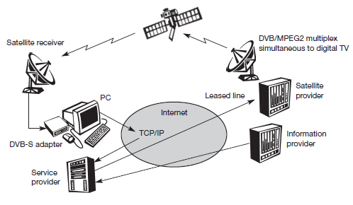
DVB for High-Speed Internet Access
Used for high-bandwidth, asymmetrical Internet access.

Slide 34
Contd..
Transmits the information to a satellite provider via a service provider/In fixed networks this is done using leased lines.
The return channel for requests etc. can be a standard TCP/IP connection via the internet.
The information for the customer will be encrypted
Typical data rates per user are;
5–30 Mbit/s for the downlink via satellite.
33 kbit/s for the return channel via standard modem, 64 kbit/s with ISDN, or several 100 kbit/s using DSL.

Slide 35
Contd..
Advantage
Transmitted along with the TV programs using free space in the transmitted data stream,
So it does not require additional lines or hardware per customer.
Disadvantage
The shared medium ‘satellite’.
If a lot of users request data streams via DVB, they all have to share the satellite’s bandwidth.
Cannot ensure QoS guarantees to all users without being very expensive.

